Slide 1

Story and Progression

Slide 2
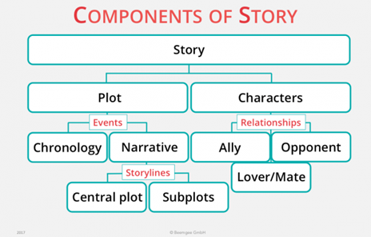
Story
Story - An account of events
Plot - The events of a story
Narrative – The way a story is told

Slide 3
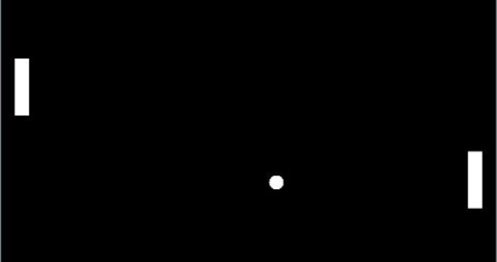

Slide 4
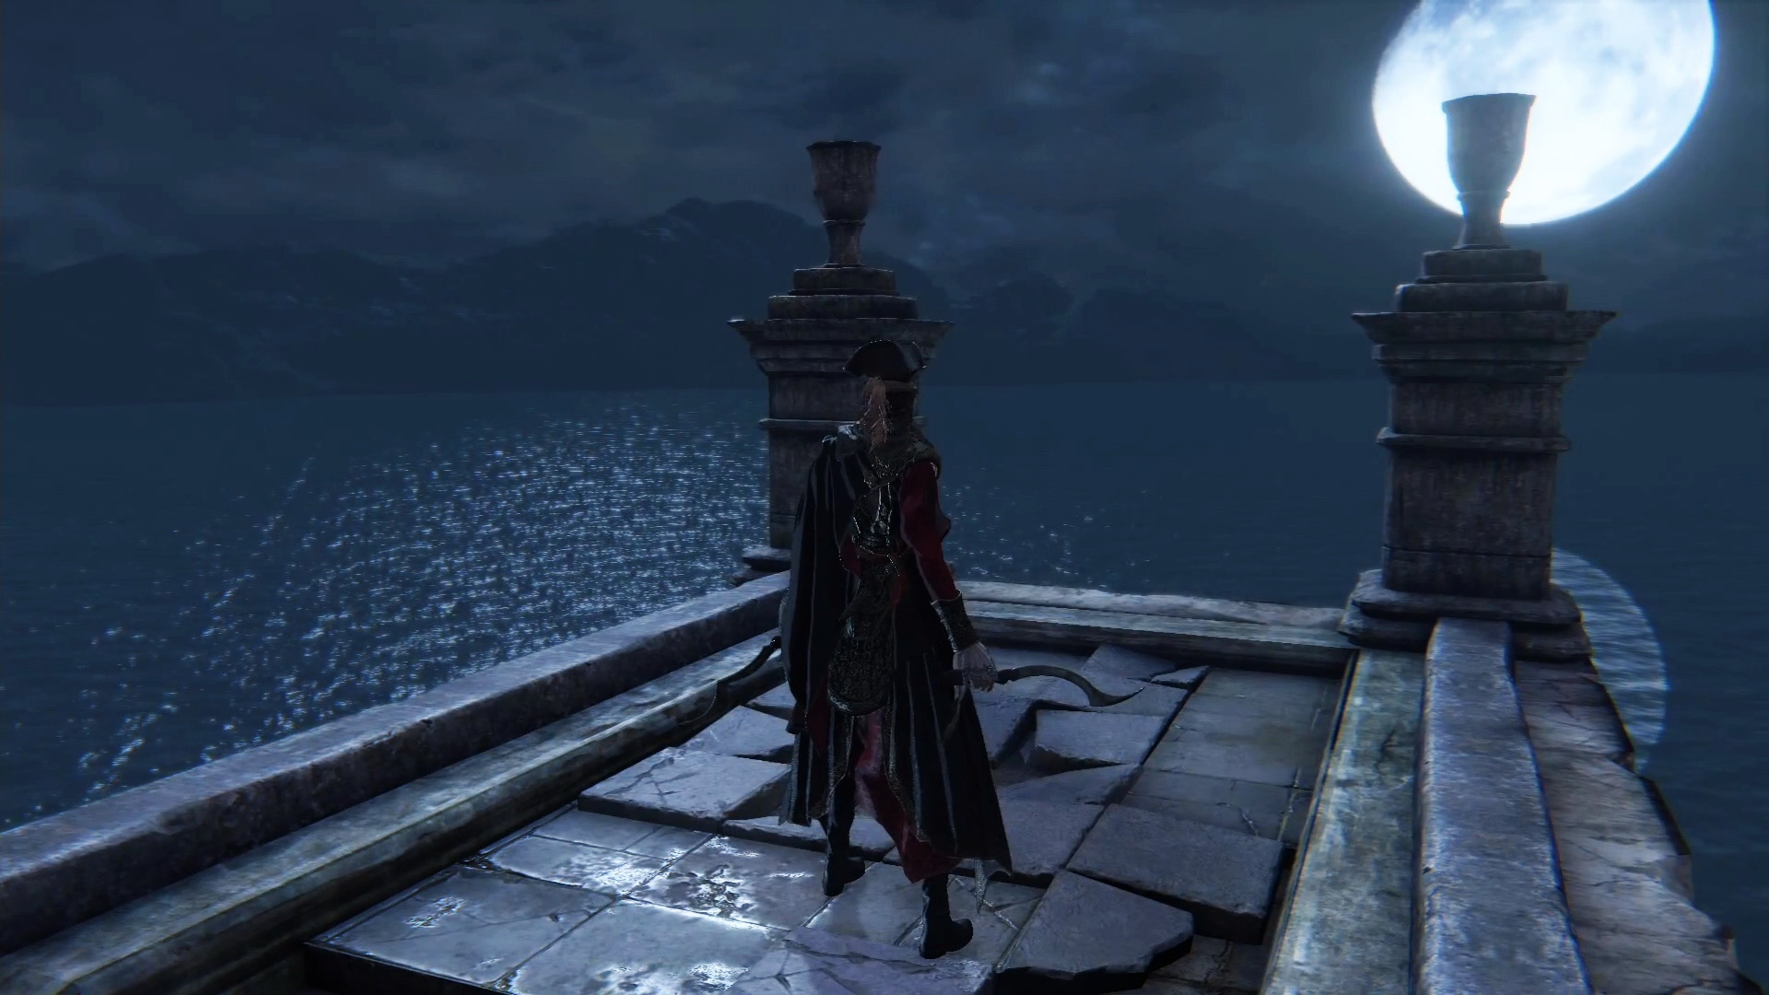

Slide 5
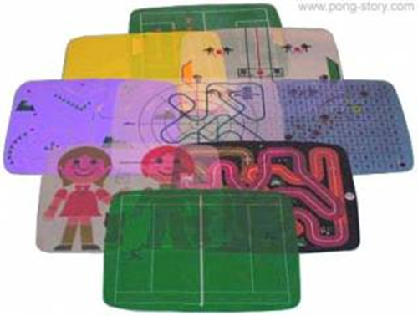
Plot, Narrative and story
Narrative is the way a story is told
How can you use gameplay as the narrative
Should you be using a video game as a narrative (even if the game is interesting the game could still be boring
Match plot with mechanics

Slide 6
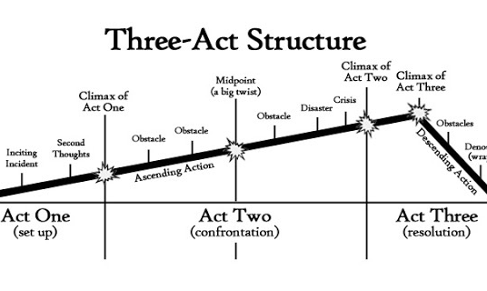
The Three Act Structure
From the story to the animations this "curve" gets used

Slide 7
Progression
How to link the plot points
How to progress through levels
How to keep mechanics fresh
How will the mechanics be dynamic
Flow chart of when mechanics are introduced / changed
Lore Mechanics
Mechanical Progression compared to story progression
"Golden path"

Slide 8
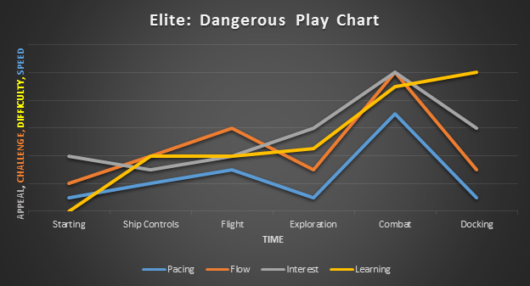

Slide 9
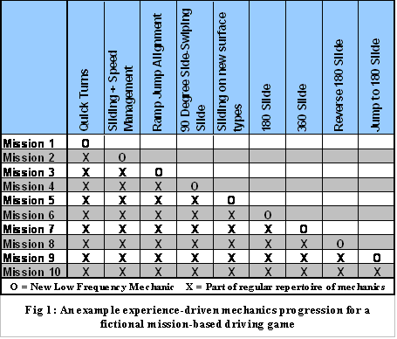
https://www.gamasutra.com/view/feature/130188/gameplay_design_fundamentals_.php?print=1

Slide 10
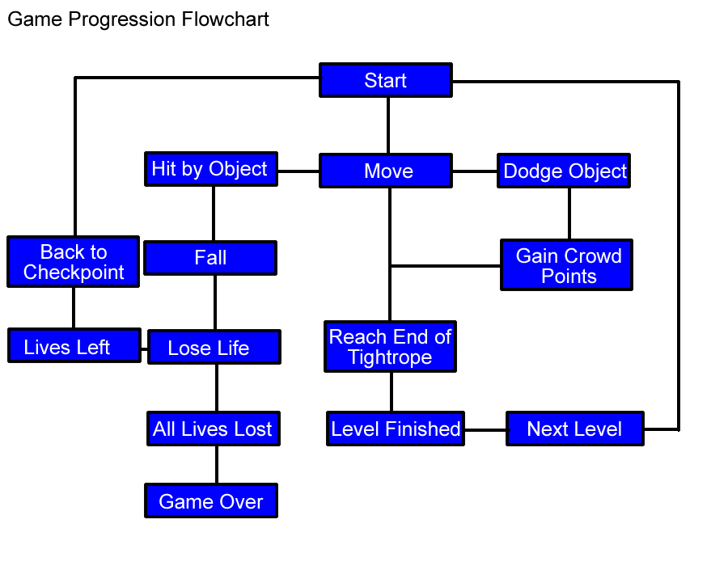
https://waldronagames.files.wordpress.com/2011/11/game-progression-flowchart.png

